Slide 1
Last day of class!

Slide 2
Announcements
Final project due tomorrow!
Please complete the SPOT scores
Bad ggplots today

Slide 3
Why do we do this?
Failure is central to academia and laughing and acknowledging our failures along the way helps us grow (and detoxifies success culture)

Slide 4

Ways to grow from (or at least not be devastated by) failure
Be honest
Be thankful
Take Responsibility
Learn from it
Move on
From: McCardle ‘The Up Side of Down: Why Failing Well is the Key to Success’

Slide 5
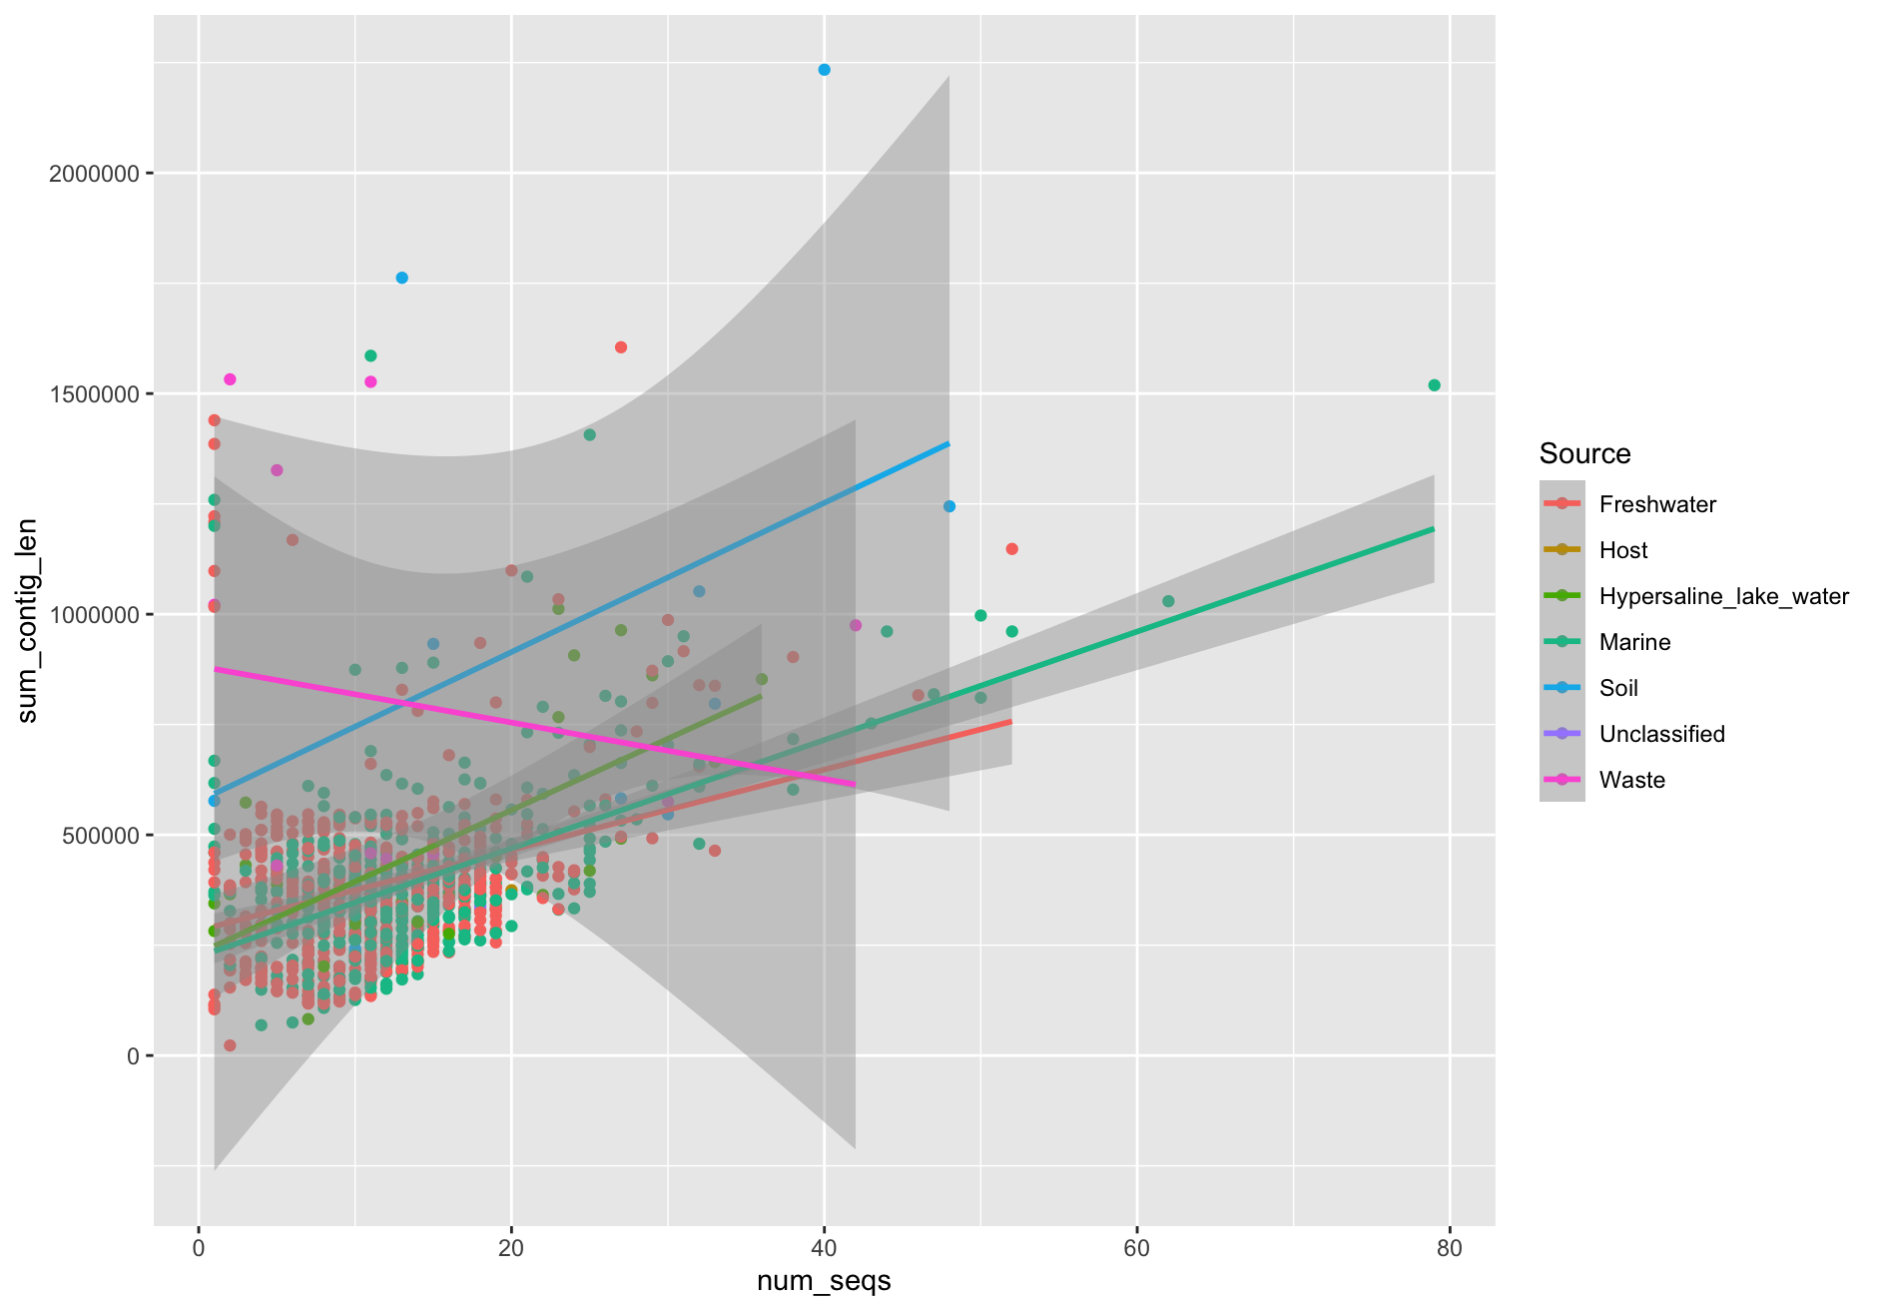
#1

Slide 6
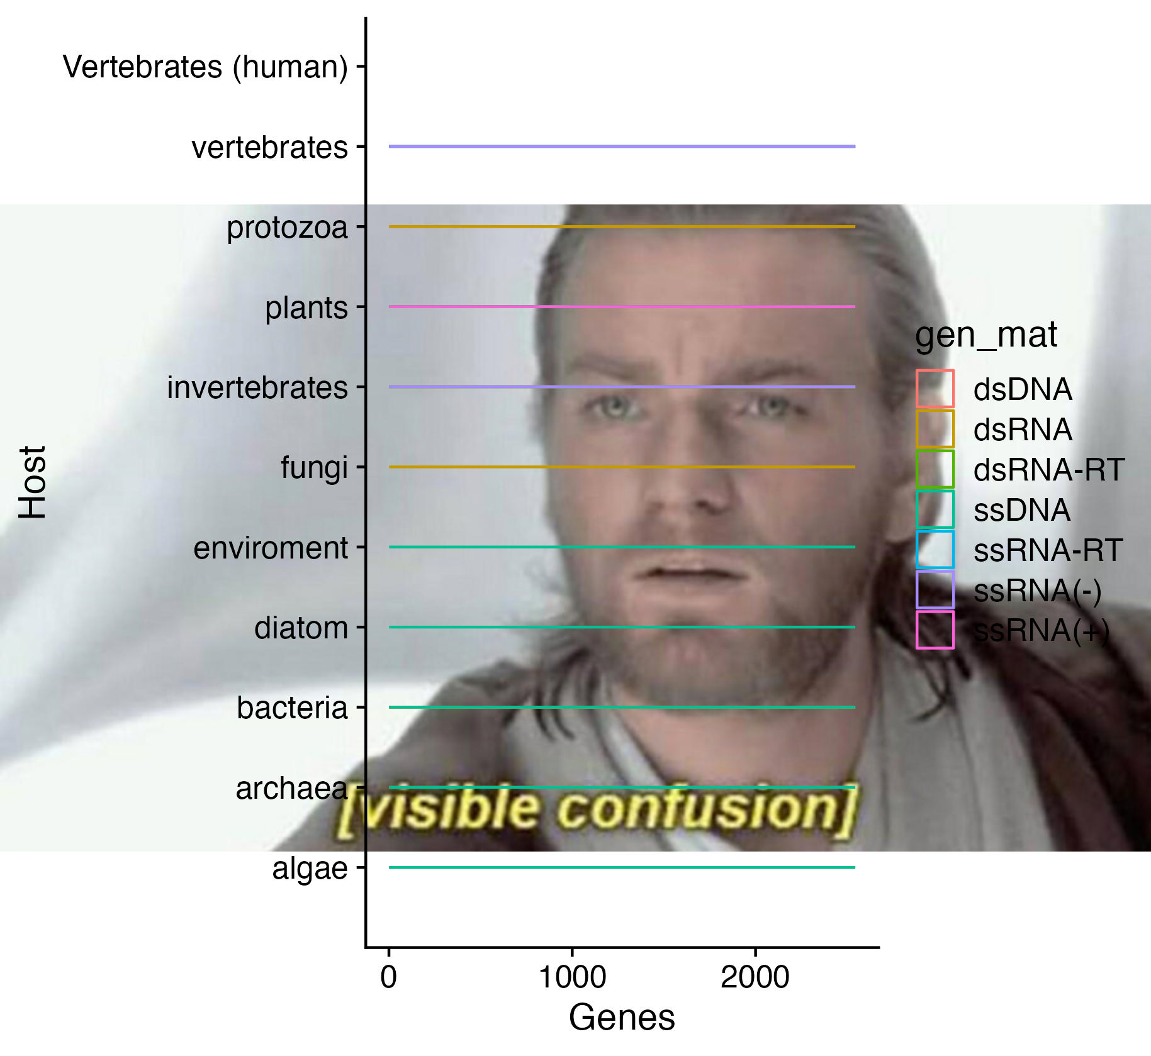
#2

Slide 7
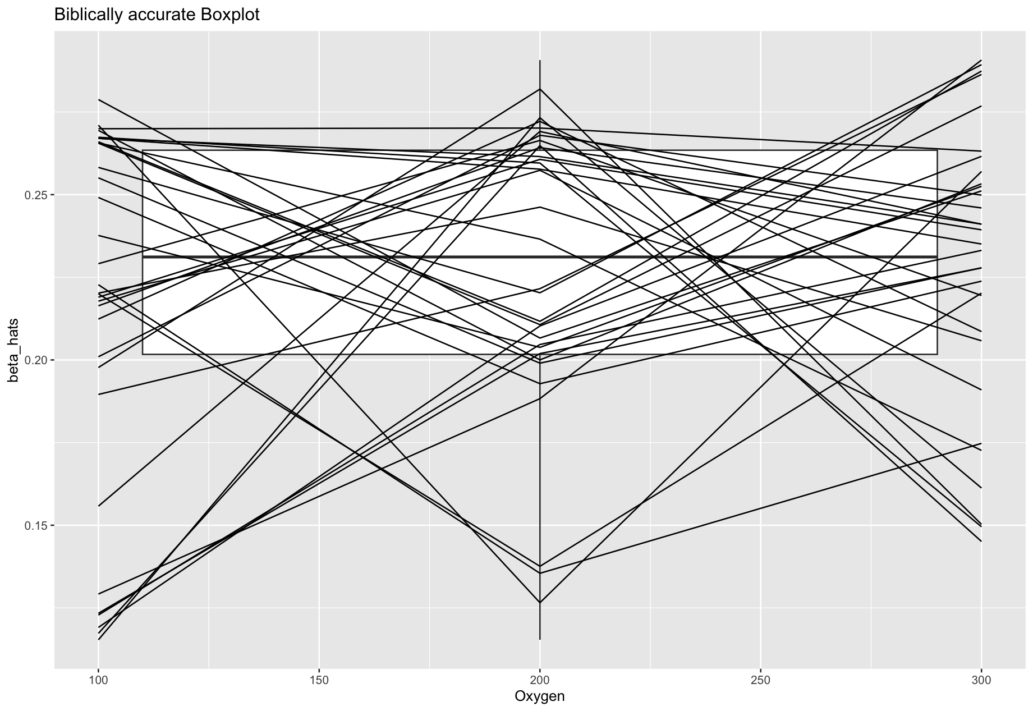
#3

Slide 8
#4

Slide 9
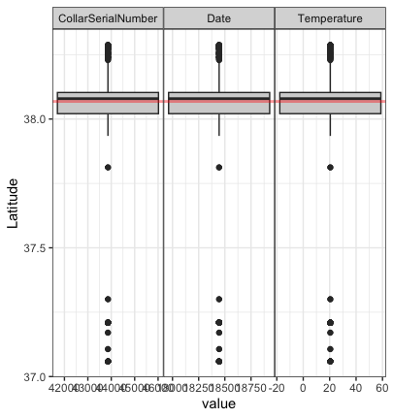
#5

Slide 10
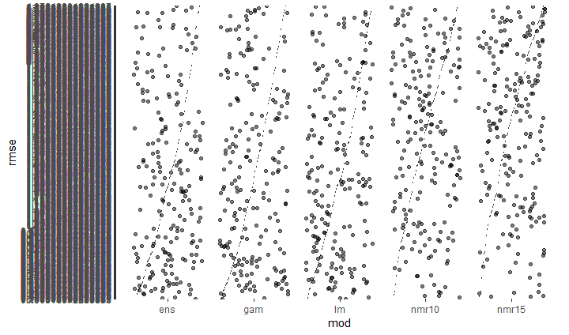
#6

Slide 11
#7

Slide 12
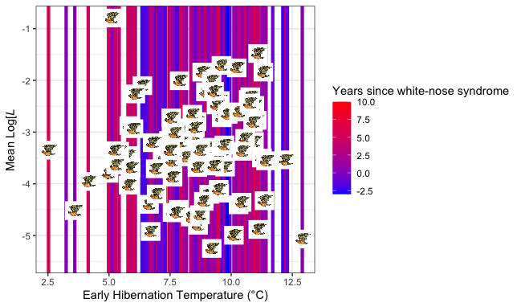
#8

Slide 13
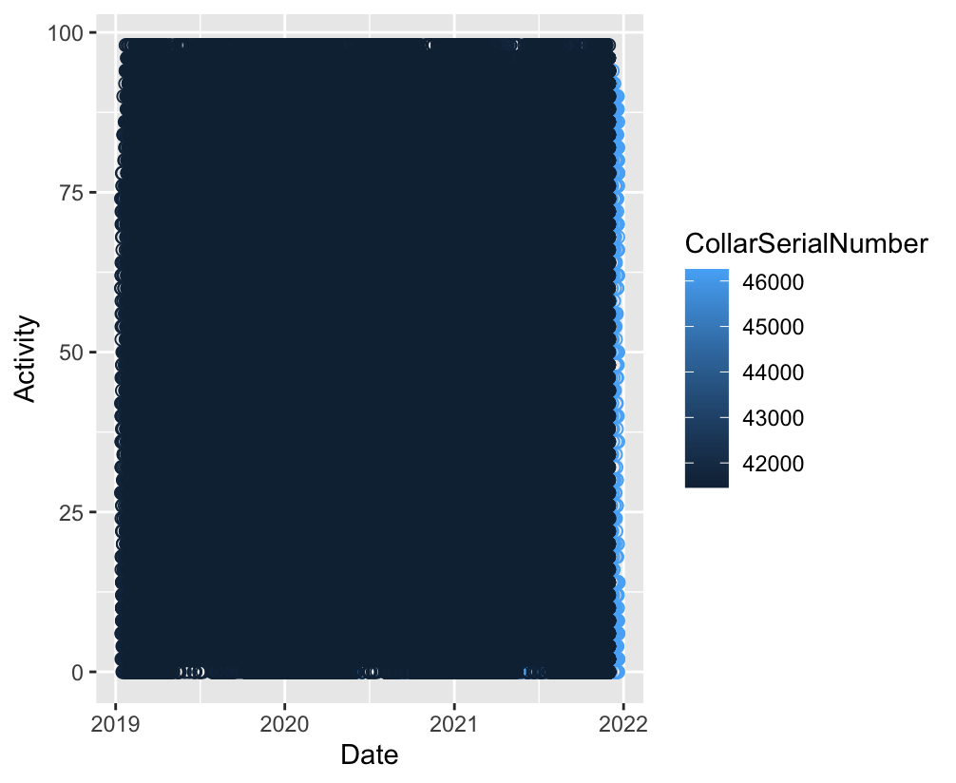
#9

Slide 14
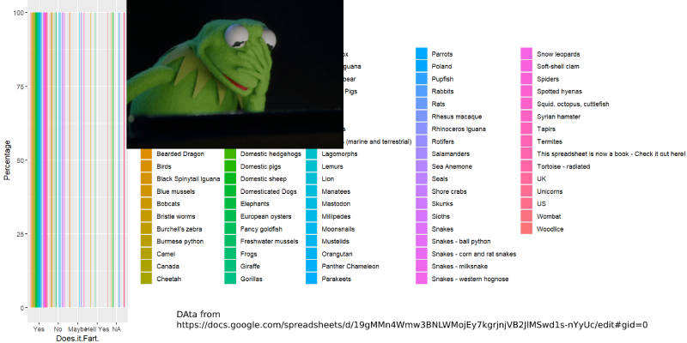
#10
kermit plot - using a dataset that describes if animals pass gas or not - I think its actually based on scientific journals but dont quote me on that haha

Slide 15
#11

Slide 16
#12

Slide 17
#13

Slide 18
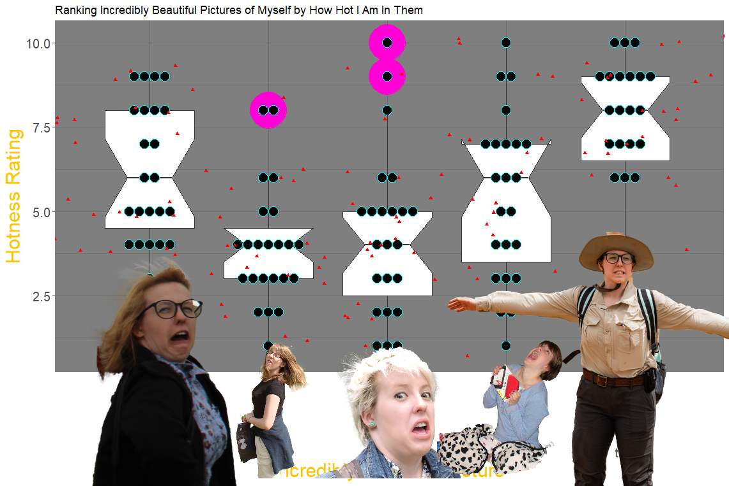
#14

Slide 19
#15

Slide 20

#16

Slide 21
#17

Slide 22
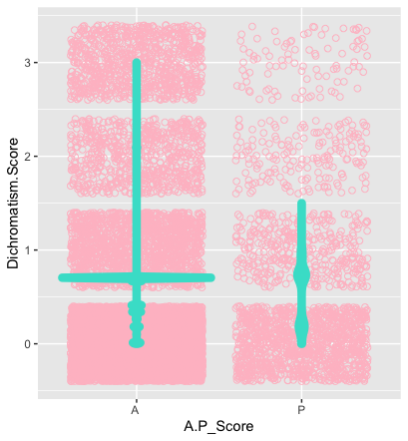
#18

Slide 23
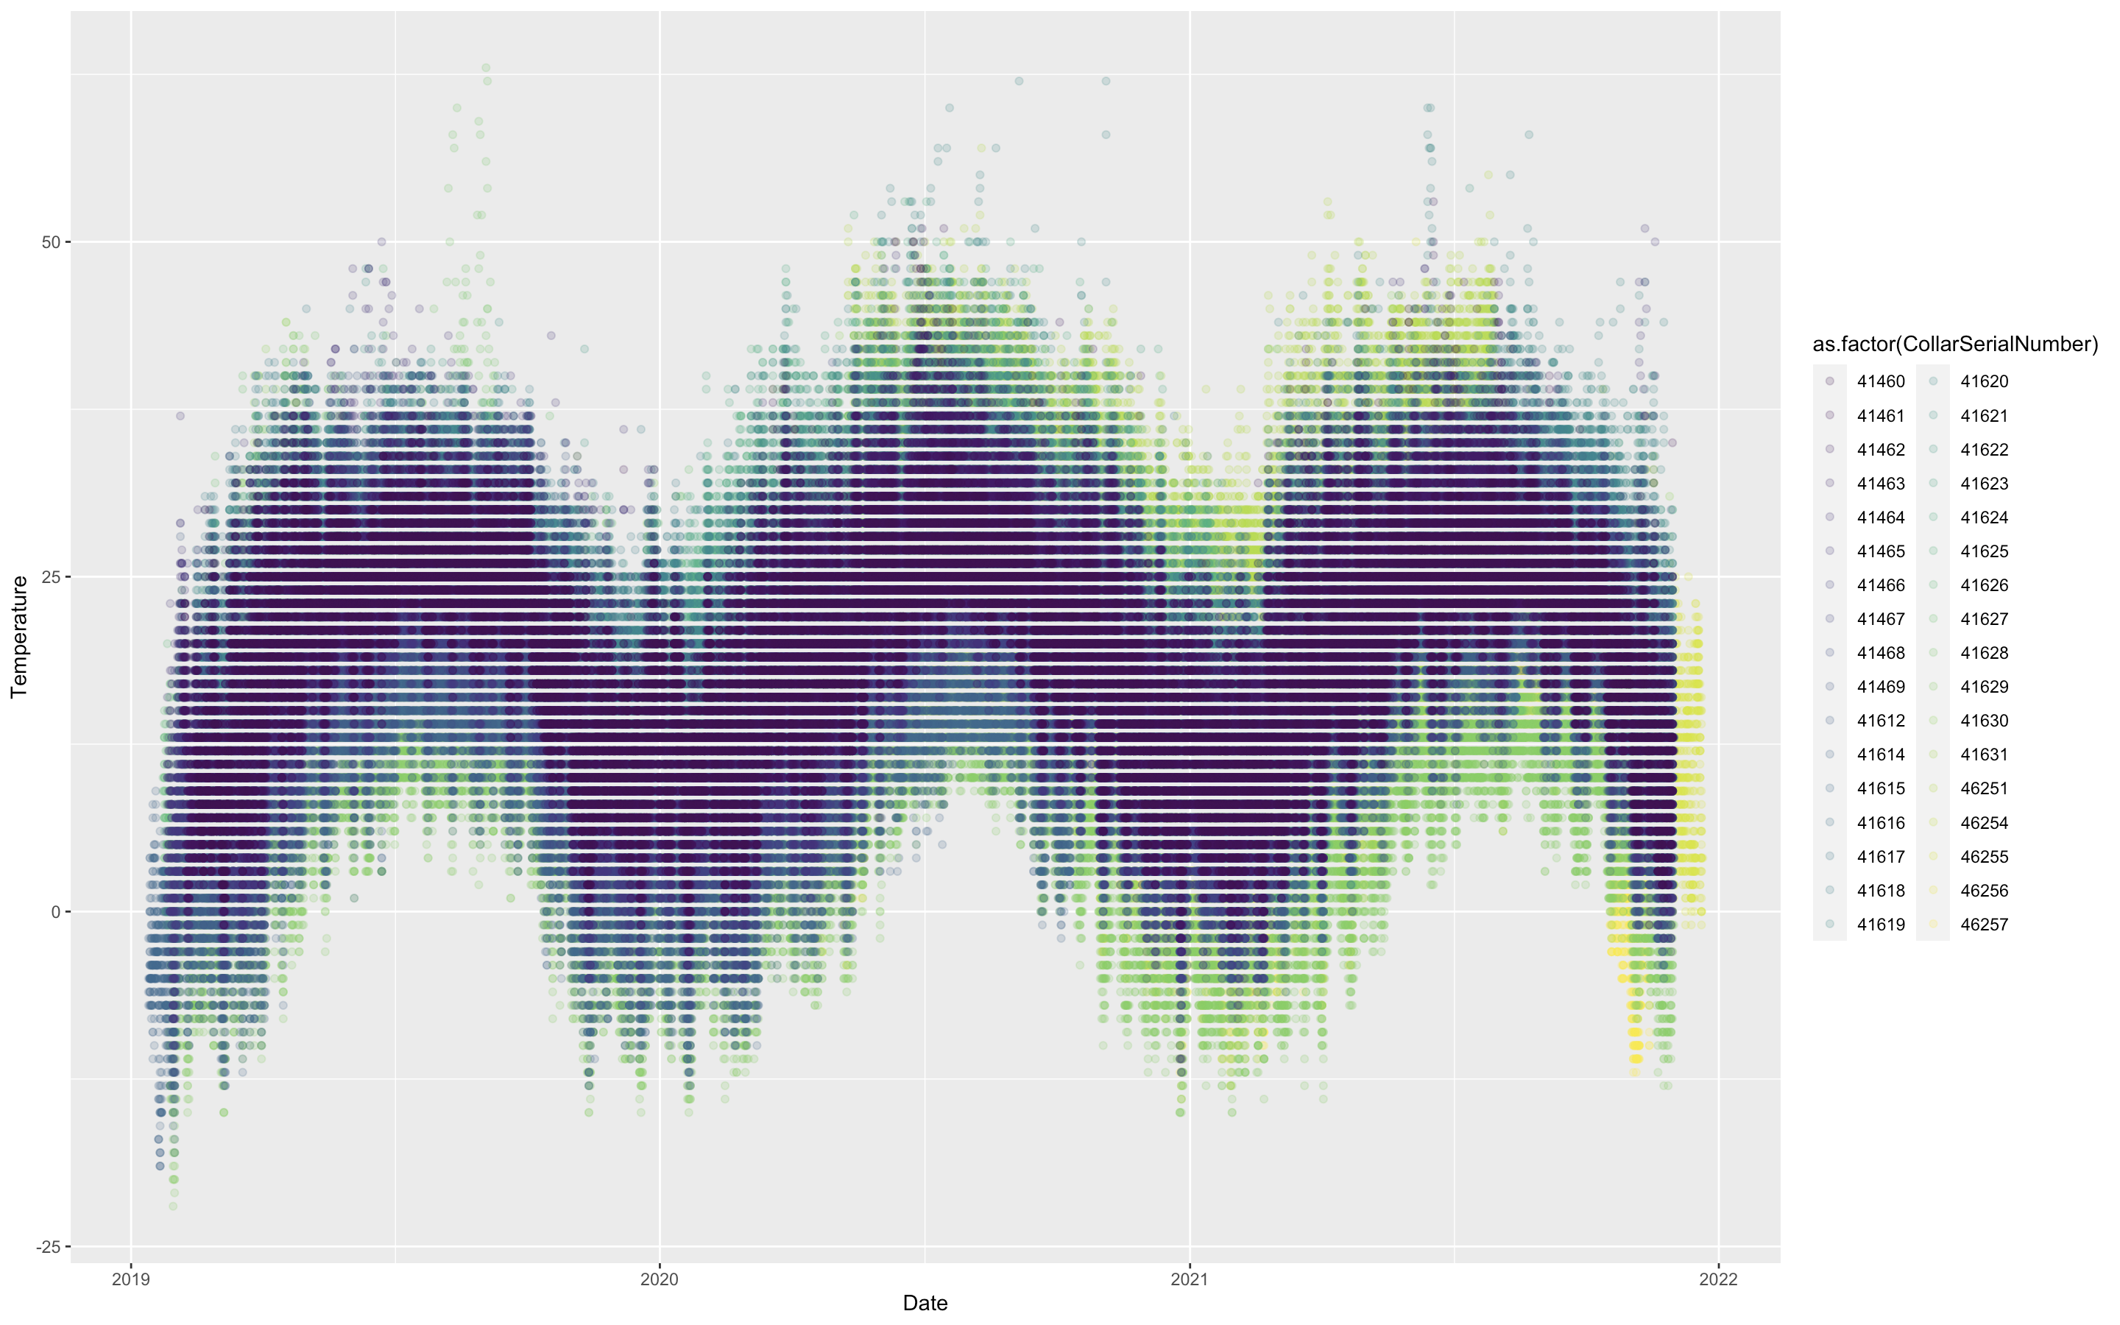
#19

Slide 24
(Mine – don’t vote!)

Slide 25
Vote at: PollEv.com/katelangwig411

